Slide 1

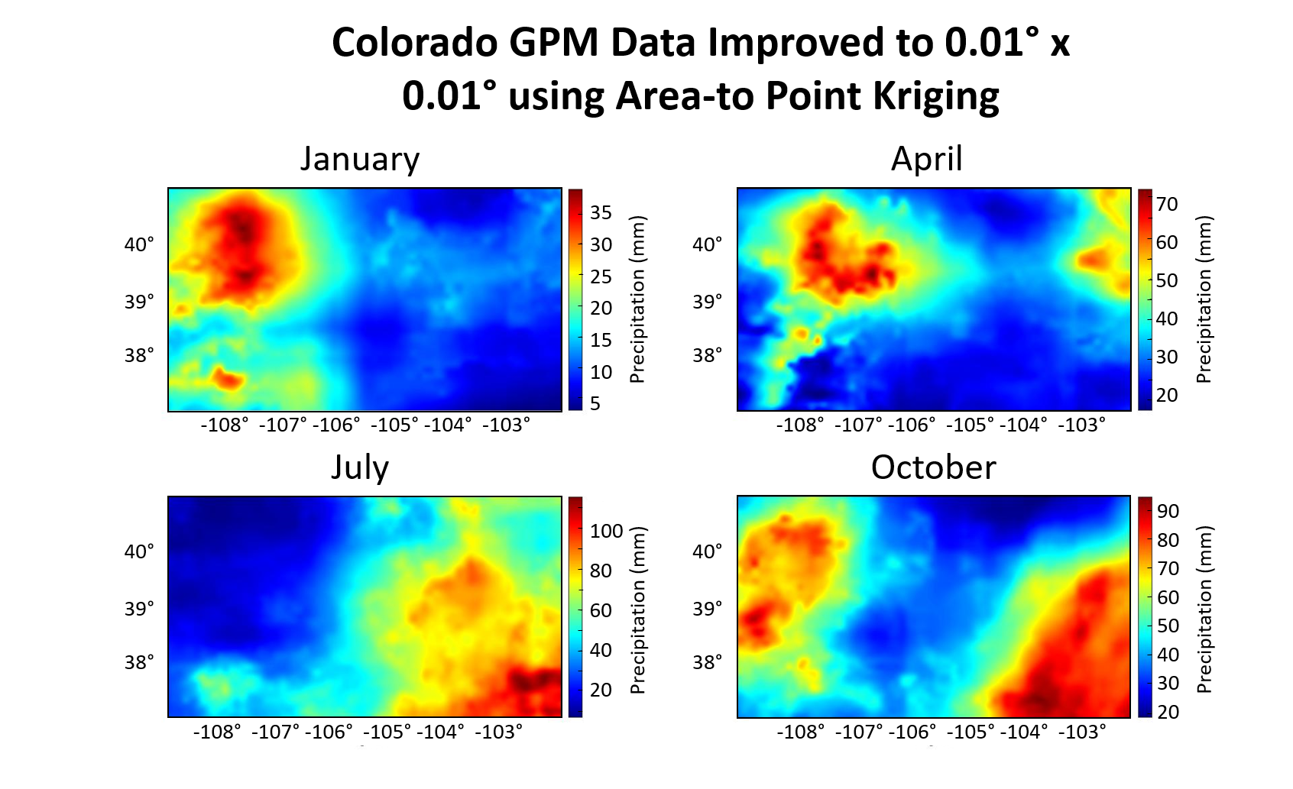
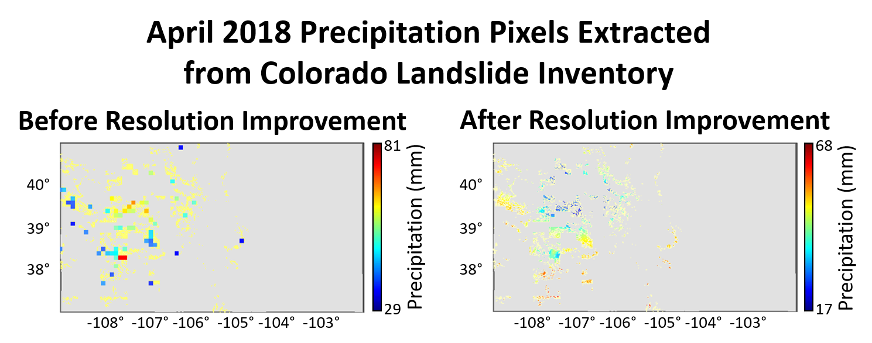
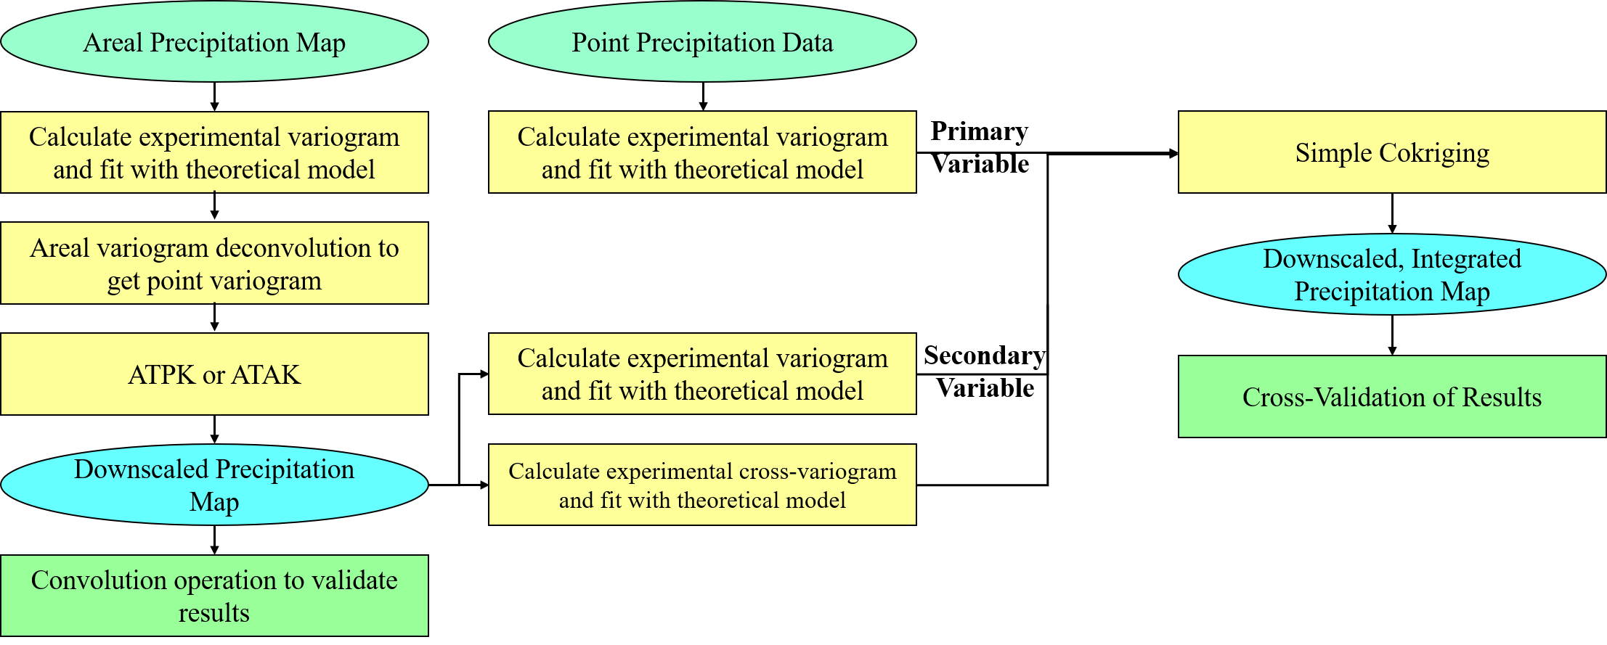
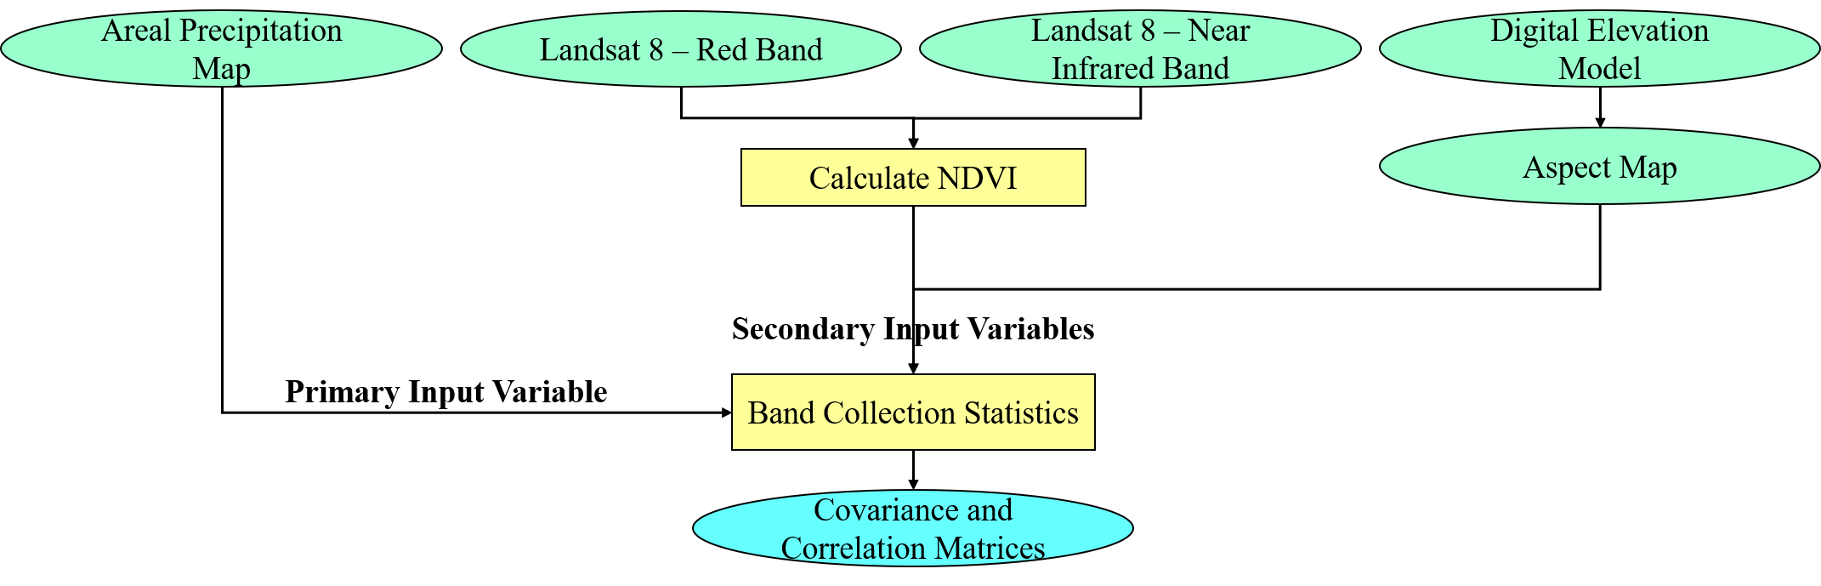
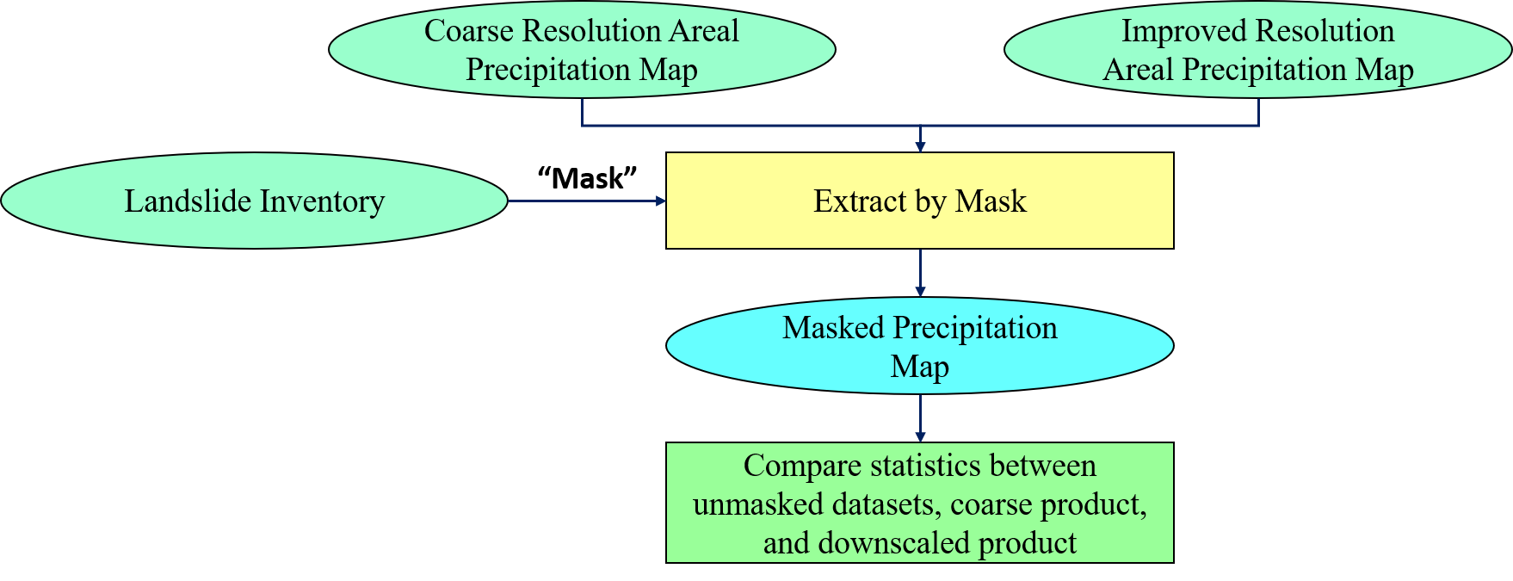
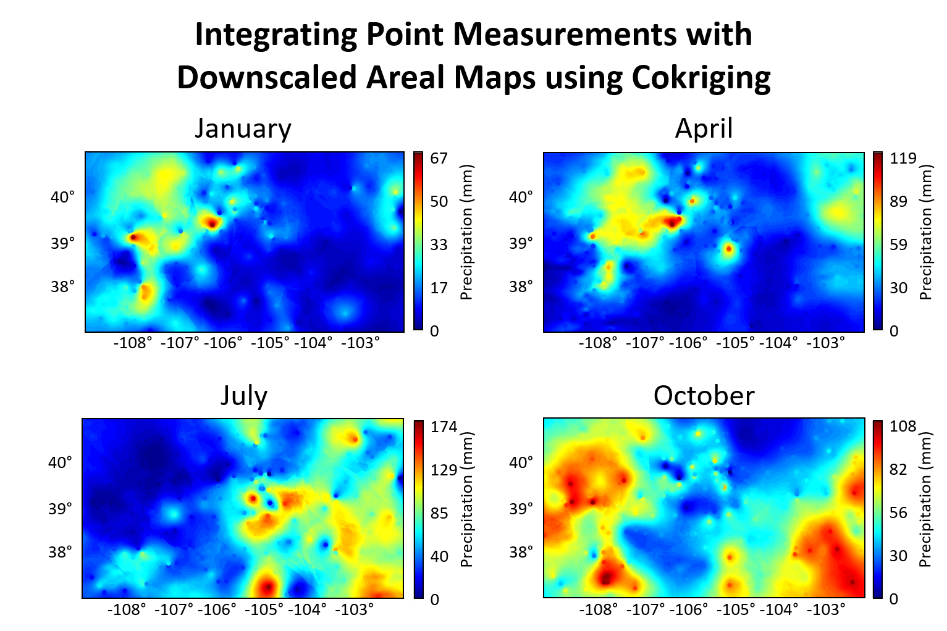
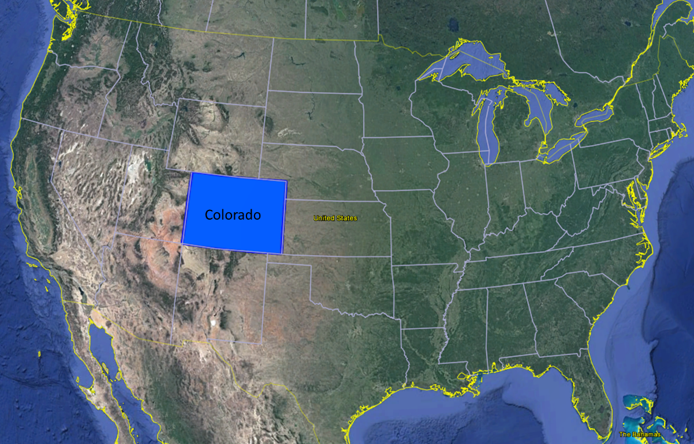
Spatial Resolution Improvement of Precipitation Measurement for Explaining Rainfall Related Landslide Hazards
NH33D-0932
Katelyn Kring¹, Snehamoy Chatterjee², Thomas Oommen³ AGU Fall Meeting, San Francisco, CA, December 2019
Abstract
Methods
Results
Results
Precipitation is a crucial triggering factor for landslides. Often landslide hazard characterization at regional or statewide scales uses sparse rain gauge measurements or assumes constant precipitation. This study explores the need for improved precipitation measurements for landslide hazard characterization. Identifying spatial and temporal precipitation patterns allow for improved understanding of their influence on geohazards, like landslides. Rain gauges collect point data in situ, and satellites gather areal precipitation data remotely at a coarse spatial resolution. Integration of point rain gauge measurements with downscaled areal precipitation data improves the overall spatial resolution of precipitation maps. The areal precipitation product being downscaled is the monthly Integrated Multi-satellitE Retrievals for Global Precipitation Measurement data (IMERG) for Colorado for several months in 2018. This project also examines the relationship between precipitation with vegetation and terrain variables. Correlation coefficients for April 2018 between Colorado’s areal precipitation with Normalized Difference Vegetation Index (NDVI), elevation, and aspect are 0.95, 0.41, and 0.11, respectively. Correlation coefficient results indicate vegetation and areal precipitation are highly correlated, but terrain variables are poorly correlated with precipitation. The spatial resolution of the product is improved tenfold from 0.1° x 0.1° to 0.01° x 0.01°. Areal precipitation maps are downscaled with area-to-point kriging (ATPK), using areal variogram deconvolution. The rain gauge station measurements for monthly precipitation are interpolated with the downscaled satellite precipitation products using several simple cokriging algorithms, and the results are compared. Finally, landslide locations are correlated to areas experiencing high precipitation throughout the year.
1
1
3
Figure 7: Downscaled, monthly accumulated precipitation maps from a tenfold spatial resolution improvement. Downscaling is performed with Area-To-Point Kriging and relies on areal variogram deconvolution.
Table 3: Comparing mean precipitation between unmasked, landslide zone masked, coarse resolution, and downscaled resolution maps.
Figure 2: Improving precipitation map spatial resolution workflow
Figure 5: Downscaled, monthly accumulated precipitation maps from a tenfold spatial resolution improvement. Downscaling is performed with Area-To-Point Kriging and relies on areal variogram deconvolution [10].
Dataset | Mean Precipitation (mm)
Coarse, Unmasked | 34.5
Coarse, Masked* | 48.0
Downscaled, Unmasked | 35.3
Downscaled, Masked* | 44.3
2
Table 1: Several spatial resolutions are considered to downscale the raw GPM data. Downscaling maps are validated by back-transforming the results with a convolution operation and calculating the correlation coefficient between the original data and the back-transformed maps. A tenfold resolution improvement, 0.01° x 0.01°, produces the highest correlation coefficient while maintaining computational efficiency.
*Statistically significant difference in means at α = 0.05
Summary
Spatial Resolution | Correlation Coefficient after back-transformation (R²)
0.05° x 0.05° | 0.9965
0.025° x 0.025° | 0.9973
0.01° x 0.01° | 0.9974
0.005° x 0.005° | 0.9974
This study modeled precipitation for the entire extent of Colorado for January, April, July, and October 2018.
NASA’s monthly GPM product’s spatial resolution is increased tenfold (Figure 5). The downscaled areal precipitation map is considered a secondary variable to interpolate in situ, monthly rain gauge point data with simple cokriging (Figure 6).
The project also determined whether NDVI, elevation, and/or aspect data correlate with April 2018 Colorado GPM data. Results show NDVI is highly correlated with areal precipitation, and elevation and aspect are poorly correlated (Table 2).
These methods can be applied to all monthly IMERG data of Colorado, from the beginning of the GPM mission in March 2014 to the present.
Comparing the downscaled resolution maps to the original resolution maps, it is evident that there is a statistically significant difference in the mean precipitation values within the landslide inventory boundaries (Figure 7).
Additionally, these methods can be applied in landslide hazard characterization in Colorado to specific landslide events or to areas that are regionally characterized as hazardous.
Background
Figure 3: Correlating areal precipitation data to vegetation and terrain variables workflow
It is impossible to compile exhaustive in situ precipitation measurements, but interpolation methods help to fill the spaces between measurements. In situ measurements are commonly taken from rain gauge stations, and stations generally are irregularly spatially distributed.
Remote sensing precipitation data, while exhaustive in coverage on a regular grid, can be too coarse of a spatial resolution for useful, fine scale prediction and modeling.
Integrating point rain gauge measurements with coarse, areal precipitation data can produce high resolution precipitation maps [1].
Mountainous regions present a challenge to capturing precipitation measurements [2]–[4]. In [1, 5] topography and vegetation are used to downscale the coarse spatial resolution satellite precipitation.
3
Research Objectives
Figure 4: Comparing coarse and improved precipitation maps to landslide inventory workflow
Authors
This research aims to interpolate monthly rain gauge measurements with a downscaled satellite precipitation product over Colorado (Figure 1) during the months of January, April, July, and October in 2018.
Data
This analysis uses the US Integrated Multi-satellitE Retrievals for GPM (IMERG) algorithm product, specifically its “Final,” Level 3, monthly, gridded data from 2018 [6].
Precipitation data for every station with monthly accumulated precipitation data in 2018 is retrieved from Colorado State University’s Colorado Climate Center [7].
The Normalized Difference Vegetation Index (NDVI) for April 2018 is calculated with Landsat-8 bands four and five (i.e., red and near-infrared bands, respectively) [8].
The USGS National Elevation Dataset (NED) includes the best quality and spatial resolution Digital Elevation Model (DEM) data for the contiguous United States [9]. From the DEM, the aspect is calculated.
We use MATLAB, ERDAS Imagine, and ArcMap 10.6 software packages for image processing and data analysis.
¹ MS Student, kekring@mtu.edu; ² Assistant Professor, schatte1@mtu.edu; ³ Associate Professor, toommen@mtu.edu
Department of Geological & Mining Engineering and Sciences, Michigan Technological University, Houghton, MI, US.
Additionally, understanding the relationships that precipitation has with vegetation and terrain, if any, can help in predicting and improving precipitation maps.
Figure 6: Cokriging results to integrate the point measurements with downscaled areal data (Figure 5). Maps are overlaid with point measurements for comparison. January and April experience the most accumulated precipitation in the Rocky Mountains region. July experiences the most precipitation in the High Plains. October experiences great accumulated precipitation in both the Rocky Mountains and High Plains regions.
References
N. W. Park, P. C. Kyriakidis, and S. Hong, “Geostatistical integration of coarse resolution satellite precipitation products and rain gauge data to map precipitation at fine spatial resolutions,” Remote Sens., vol. 9, no. 3, pp. 1–19, 2017.
C. Zhan, J. Han, S. Hu, L. Liu, and Y. Dong, “Spatial Downscaling of GPM Annual and Monthly Precipitation Using Regression-Based Algorithms in a Mountainous Area,” Adv. Meteorol., vol. 2018, 2018.
X. Pan, Y. Zhang, K. Yang, X. Li, J. He, and X. Han, “Comparison of Downscaled Precipitation Data over a Mountainous Watershed: A Case Study in the Heihe River Basin,” J. Hydrometeorol., vol. 15, no. 4, pp. 1560–1574, 2014.
J. Liu, W. Zhang, and N. Nie, “Spatial Downscaling of TRMM Precipitation Data Using an Optimal Subset Regression Model with NDVI and Terrain Factors in the Yarlung Zangbo River Basin, China,” Adv. Meteorol., vol. 2018, pp. 1–13, 2018.
Y. Chen et al., “A new downscaling-integration framework for high-resolution monthly precipitation estimates: Combining rain gauge observations, satellite-derived precipitation data and geographical ancillary data,” Remote Sens. Environ., vol. 214, no. April, pp. 154–172, 2018.
G. J. Huffman, “Algorithm Theoretical Basis Document (ATBD) Version 4.1 NASA Global Precipitation Measurement (GPM) Integrated Multi-satellitE Retrievals for GPM (IMERG),” no. September, 2013.
Colorado State University, “Colorado Climate Center - Data,” 2019. [Online]. Available: https://climate.colostate.edu/data_access.html. [Accessed: 24-Apr-2019].
U.S.G.S., “EarthExplorer - Home.” [Online]. Available: https://earthexplorer.usgs.gov/. [Accessed: 24-Apr-2019].
U.S.G.S, “1 degree digital elevation model for Colorado, New Mexico, Utah and Arizona, USA.” [Online]. Available: https://databasin.org/datasets/3cf598b2d67b4f9f8e3ff47fd5b5ae37
P. Goovaerts, “Kriging and semivariogram deconvolution in the presence of irregular geographical units,” Math. Geosci., vol. 40, no. 1, pp. 101–128, 2008.
Finally, the precipitation maps are compared to landslide locations to understand how improved precipitation data can give insight into landslide characterization.
2
Table 2: April 2018 Correlation Results between Areal Precipitation, Vegetation, and Terrain Variables
Figure 1. Case study location
Variable | R² between Variable and Areal Precipitation
NDVI | 0.95
Elevation | 0.41
Aspect | 0.11

